Slide 1

VOLUNTEERING. OFFERING HELP
Лазебник О.П.
учитель английского языка,
МБОУ «СТШ»,
г.Сургут, Россия

Slide 2



SYMBOL?

Slide 3
charity
aid programme
donate money
help
participate
VOLUNTEERING
благотворительная\
волонтерская
организация
хочу стать
волонтером
программа
помощи
иметь опыт
участвовать в благотворительной акции
организовать помощь

Slide 4
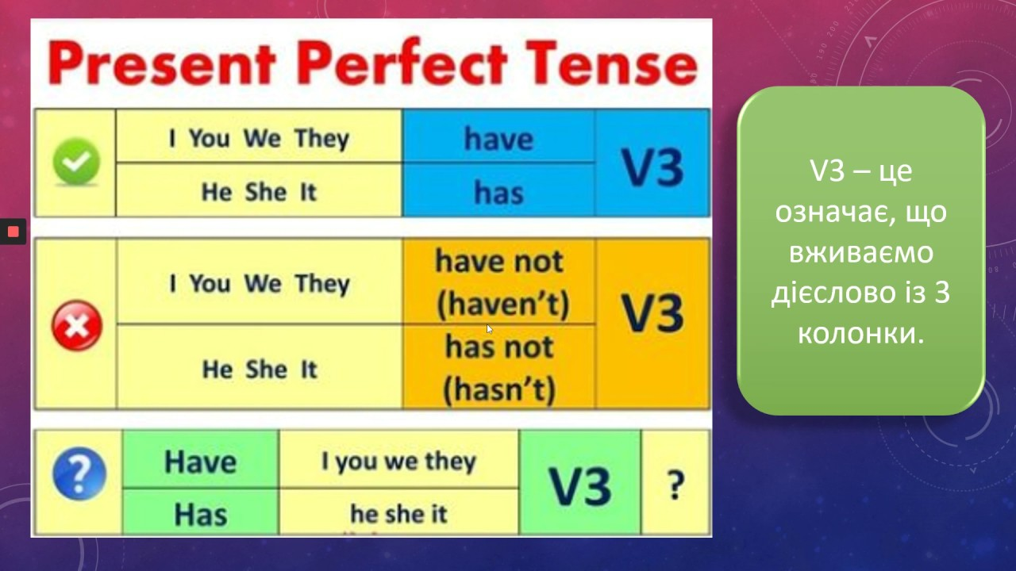
Have you ever …?
Have you ever participated in aid programmes?
Yes, I have \ No I haven’t.
I’ve collected old clothes.
WATCH THE VIDEO AND TICK THE PHRASES FROM IT
donate money
make homemade masks
supply food from supermarkets
teach to organize or join videoconferences
collect and distribute laptops
deliver food to hospitals make phone calls to seniors
provide services
the covid-19 pandemic

Slide 5
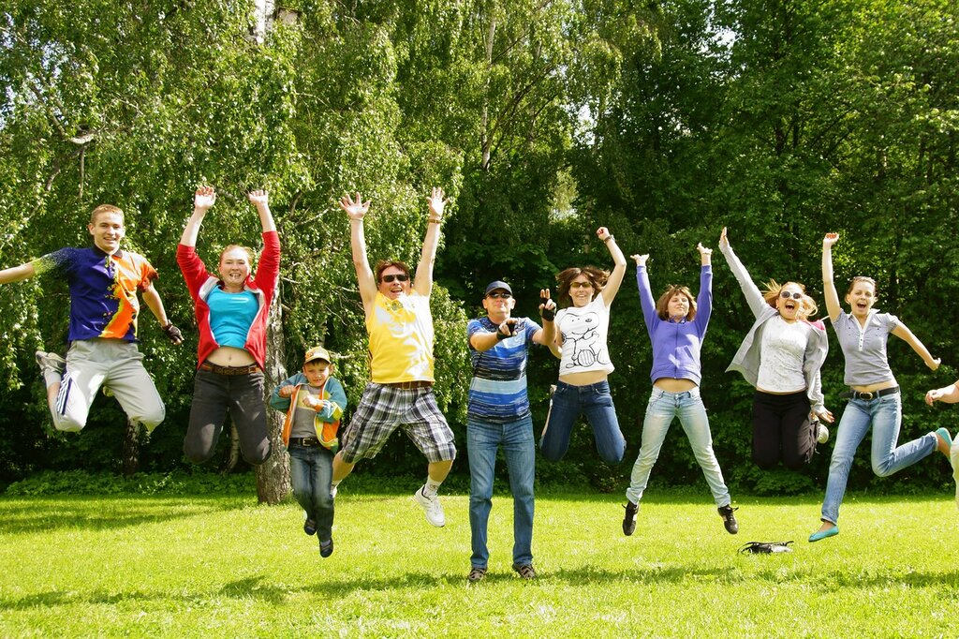
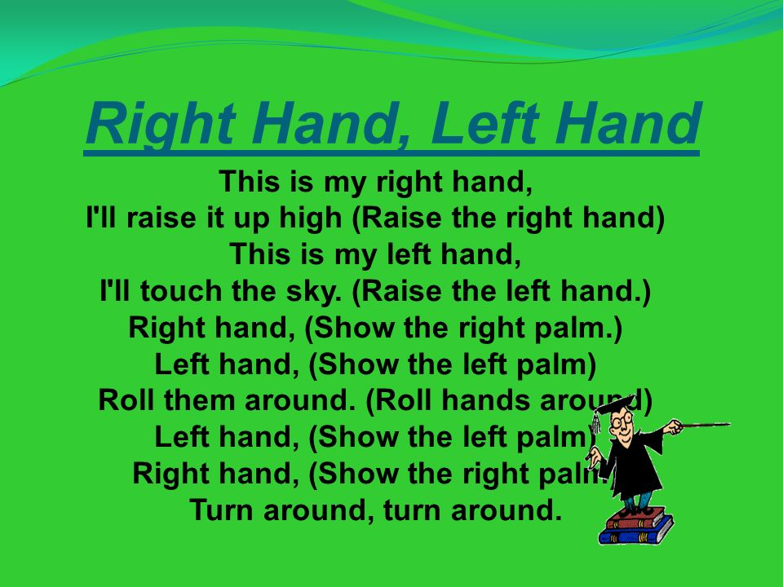
It’s PT time!

Slide 6
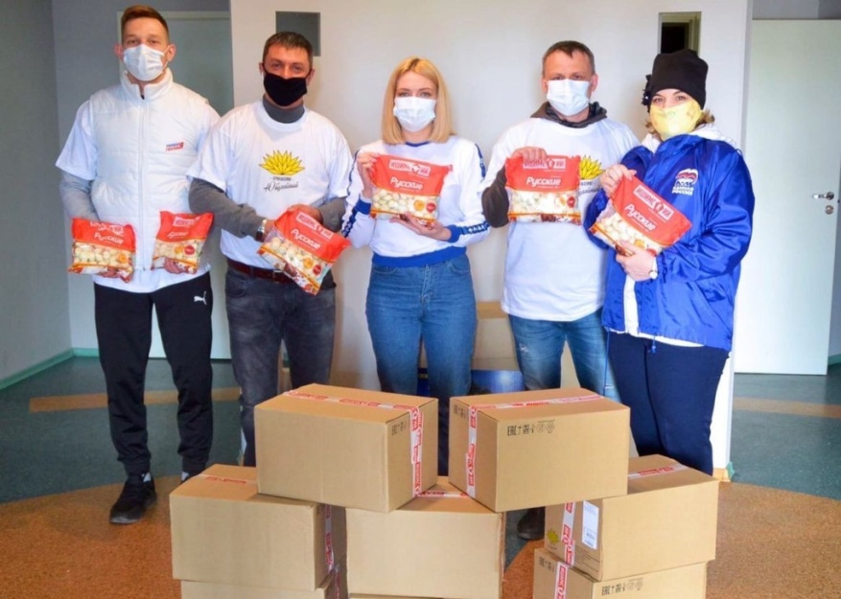
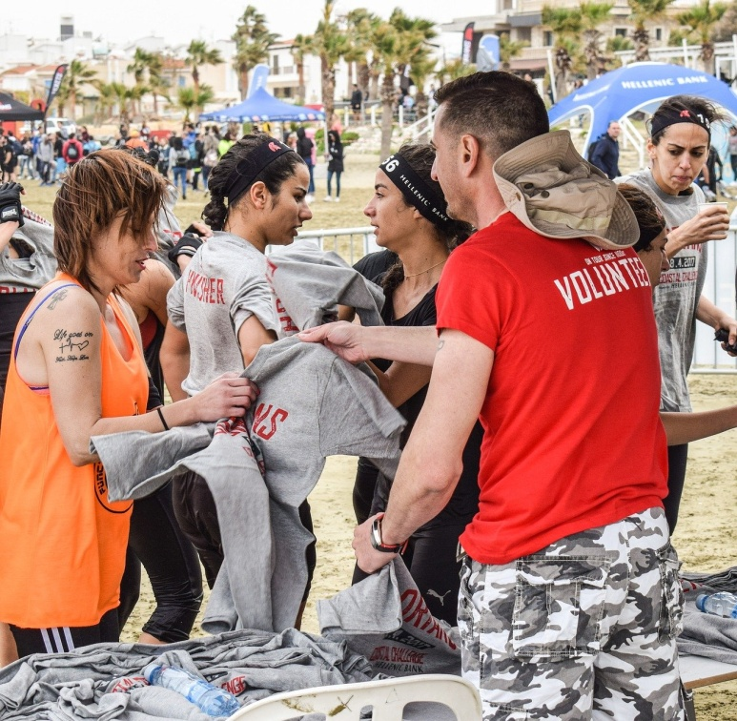
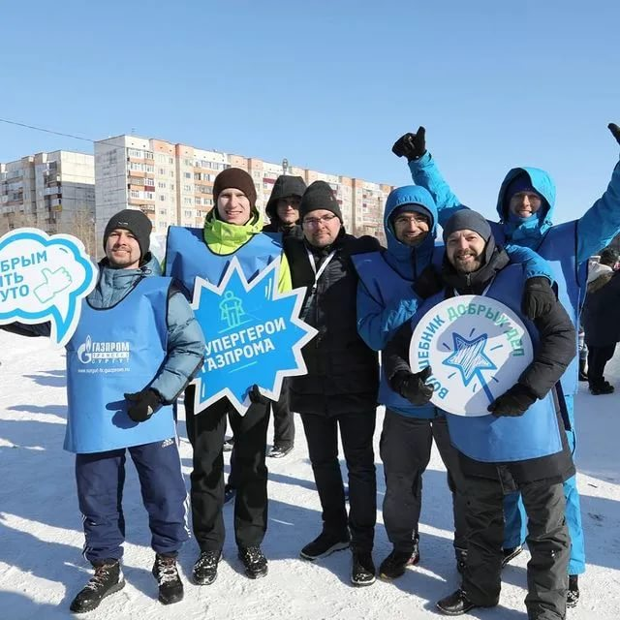
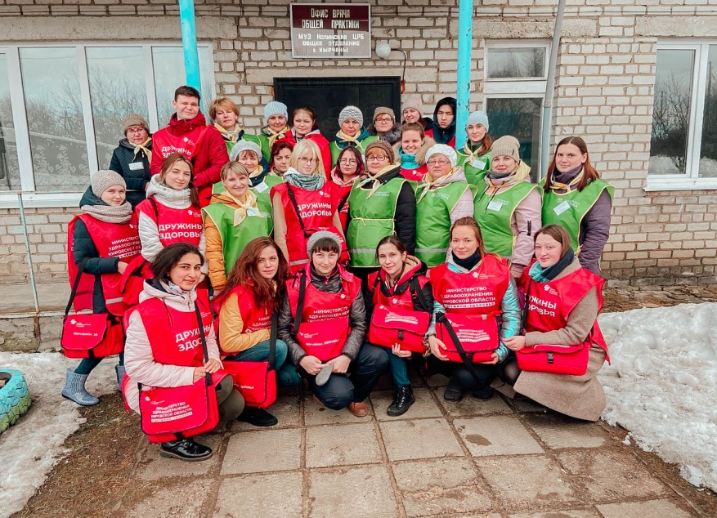
There are nearly … volunteers in Surgut. All of them want to help … . Volunteers provide …, deliver …, make … , etc. Sometimes elderly people need nothing but to … because they feel … . Some volunteers spend one or two hours on charity but others work … . Their work is … . I think that volunteers are … . I’d like to participate in … because …

Slide 7
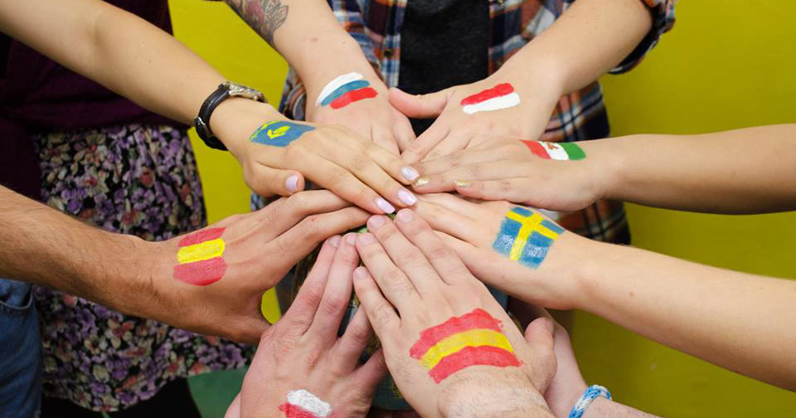
“Volunteers are love in motion!”

